Slide 1
4 June 2018
REN21 Secretariat
gsr@ren21.net

Slide 2
REN21 is a global multi stakeholder network dedicated to the rapid uptake of renewable energy worldwide.
NGOs:
CAN, CEEW, FER, GACC, GFSE, Greenpeace International, ICLEI, ISEP, MFC, SLoCaT, REI, WCRE, WFC, WRI, WWF
International Organisations:
ADB, APERC, ECREEE, EC, GEF, IEA, IEC, IRENA, RCREEE, UNDP, UN Environment, UNIDO, World Bank
Industry Associations:
ARE, ACORE, ALER, APREN, CREIA, CEC, EREF, GOGLA, GSC, GWEC, IREF, IGA, IHA, RES4MED, WBA, WWEA
Governments: Afghanistan, Brazil, Denmark, Germany, India, Mexico, South Africa, Spain, UAE, USA
Science & Academia:
Fundacion Bariloche, IIASA, ISES, NREL, SANEDI, TERI
Notes:
REN21 is the global renewable energy policy multi-stakeholder network that connects a wide range of key actors.
REN21’s goal is to facilitate knowledge exchange, policy development, and joint action towards a rapid global transition to renewable energy.
REN21 brings together governments, nongovernmental organisations, research and academic institutions, international organisations, and industry to learn from one another and build on successes that advance renewable energy.
The REN21 network is supported by a lean Secretariat based at United Nations Environment in Paris, France.

Slide 3
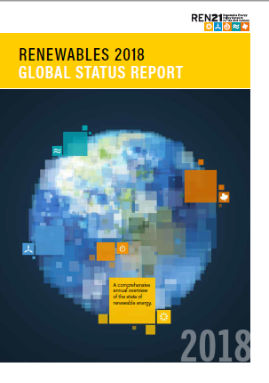
Renewables Global Status Report
Collaborative annual reporting since 2005 building on international expert community
The report features:
01. Global Overview
02. Policy Landscape
03. Market & Industry Trends
04. Distributed Renewables for Energy Access
05. Investment Flows
06. Energy Systems Integration and Enabling Technologies
07. Energy Efficiency
08. Feature: Corporate Sourcing of Renewables
Notes:
The REN21 Renewables Global Status Report (GSR) provides an annual look at the advances in renewable energy markets, policy frameworks and industries globally.
The production of the GSR builds on a multi-stakeholder community of over 900 experts, who has helped REN21 produce what is today one of the most widely referenced reports in the sector.
This year’s GSR 2018 marks 13 years of REN21 reporting; it includes thousands of data points and uses hundreds of documents and personal communications with experts from around the world to provide the most up-to-date information available.

Slide 4
Notes:
- REN21 is a multi-stakeholder network that is built on an international community of over 900 experts from governments, inter-governmental organisations, industry associations, non-governmental organisations, and science and academia. It grows from year to year and represents an increasing diversity of sectors.
- REN21 provides a platform for this wide-ranging community to exchange information and ideas, to learn from each other and to collectively build the renewable energy future.
This network enables the REN21 Secretariat, among other things, to produce its annual flagship publication, the Renewables Global Status Report (GSR). The report is a truly collaborative effort where the contributors
and peer reviewers work alongside an international authoring team and the REN21 Secretariat.

Slide 5
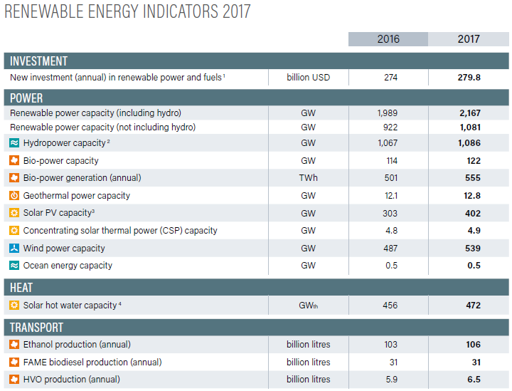
Another Extraordinary Year for Renewable Energy
Total global capacity: +9% compared to 2016, 2,167 GW at year’s end (1,081 GW not incl. hydro)
Share in newly installed renewable power capacity:
Solar PV: 55%
Wind: 29%
REN21 Renewables 2018 Global Status Report
Notes:
2017 was another great year for renewable energy:
Total global renewable capacity was up 9% compared to 2016, to more than 2,167 GW at year’s end.
This development was mainly driven by solar PV and wind: Solar PV represented more than 55% of newly installed renewable power capacity in 2017, while wind represented 29%.

Slide 6
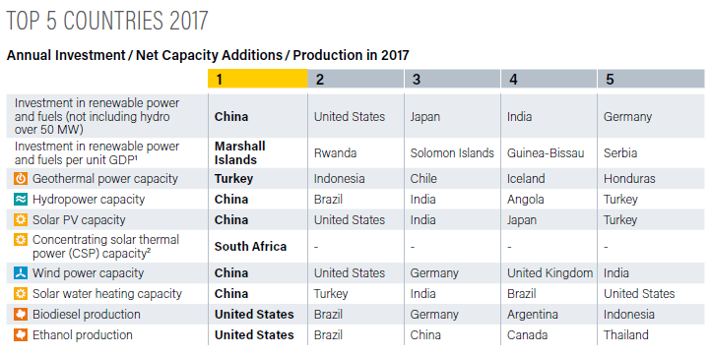
Renewable Energy “Champions”
REN21 Renewables 2018 Global Status Report
Notes:
The Global Status Report provides an overview of renewable energy champions in different areas.
Let’s look at annual investment/capacity additions - In absolute number, the top countries for investment in RE power and fuels were: China, the US, Japan, India and Germany.
However, when you look at investment relative to GDP, you get a completely different list of countries. The countries now are: the Marshall Islands, Rwanda, Solomon Islands, Guinea-Bissau and Serbia, which clearly highlights the rapid advancement of renewable energy in developing countries.

Slide 7
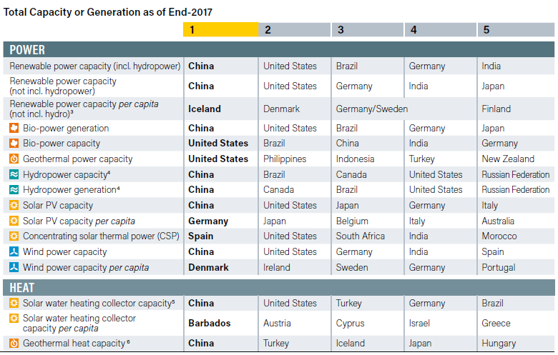
Renewable Energy “Champions”
REN21 Renewables 2018 Global Status Report
Notes:
Now lets look at the “Champions” when it comes to total RE capacity installed. In absolute figures including hydro, this list reads: China, US, Brazil, Germany, and India.
When looking at total RE capacity per capita (without hydro) the list reads as follows: Iceland, Denmark, Germany/Sweden and Finland – 5 European countries in the pole position.
Similarly in the heating sector, the list of countries changes entirely when looking at total solar water collector capacity installed and per capita, with the 5 leading countries being Barbados, Austria, Cyprus, Israel, and Greece.

Slide 8
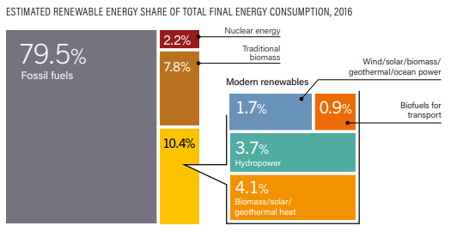
Renewable Energy in Total Final Energy Consumption
As of 2016, renewable energy provided an estimated 18.2% of global final energy consumption
10.4% was provided by modern renewables (+0.2% compared to 2015)
7.8% was provided by traditional biomass (-2.4% than 2015)
REN21 Renewables 2018 Global Status Report
Notes:
Although the share of renewable energy in total final energy consumption remains low (18,2%), it keeps rising with modern renewables representing 10.4% in 2016, 0.2% more than in 2015, mostly due to impressive growth in solar PV and wind.
We will see that the developemnts differ significantly between the sectors

Slide 9
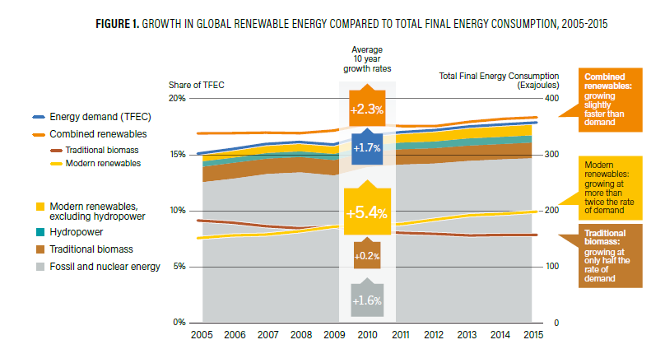
Renewable Energy in the World
REN21 Renewables 2018 Global Status Report

Slide 10
Renewable Energy in TFEC by Sector

Slide 11
Carbon Pricing Policies

Slide 12
Heating and Cooling
RE share in heating and cooling was X% in 201X
Deployment of renewable technologies in H&C continued to be constrained by: low fossil fuel prices and lack of policy support
The vast majority of renewable heat (buildings) continued to be supplied by: traditional biomass (21.8%), with smaller contributions from modern renewables (4%) such as solar thermal and geothermal energy
REN21 Renewables 2018 Global Status Report
Notes:
The RE share in heating in cooling was only of X%
Modest improvements achieved, but renewable heating and cooling still constrained by low fossil fuel prices and lack of policy support.
In 2017, the vast majority of renewable heat continued to be supplied by biomass, with smaller contributions from solar thermal and geothermal energy.

Slide 13
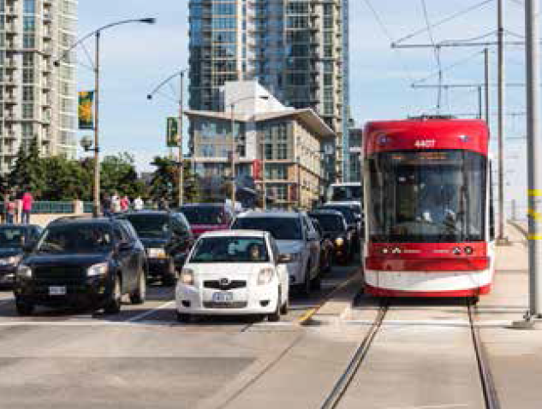
Transport
Overall, the share of renewable energy in transport was X% in 201X
RE share in road transport: 4.2% in 2016 (estimated, nearly all from biofuels)
Electrification trend: EVs on the road passed the 3 million mark in 2017 (+70%, but only 1% of light vehicle market)
REN21 Renewables 2018 Global Status Report
Potential to create a new market for renewable energy and facilitate the integration of higher shares of VRE
Notes:
- The RE share in transport was only of X%
The overall renewable share of road transport energy use was an estimated 4.2% in 2016, with nearly all of that from biofuels (IF WE HAVE THE OTHER FIGURE, THEN DON’T INCLUDE THIS ONE)
Liquid biofuels remain the primary renewable energy in the transport sector
However, electrification continues to expand and represents great opportunities to integrate renewables in the transport sector, in particular in rail and road. It also offer the opportunities to facilitate the integration of variable renewable energy.
- Electric passenger vehicles (EVs) on the road passed the 3 million mark in 2017, even though annual sales are still only a very small proportion of the global market (1%)
- Further policy support for renewable energy in the transport sector is needed, to build on existing synergies.

Slide 14
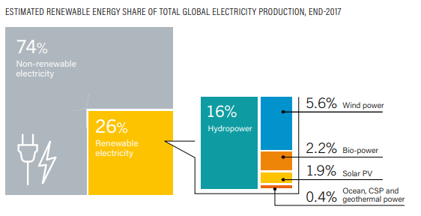
Power Sector
In 2017, renewables accounted for: 70% of net additions to global power generation capacity
Providing 26% of global electricity demand
Progress in the power sector shows that the transition to renewable energy is possible!
REN21 Renewables 2018 Global Status Report
Notes:
- As renewables uptake has mainly been driven by solar PV and wind, the uptake is mainly happening in the power sector
- Taken together, renewables accounted for an estimated 70% of net additions to global power generation capacity in 2017. And provided 26% of global electricity demand.
- It is safe to say that the global energy transition is well underway in the power sector which shows that it is possible!
Again, much of this progress is due to falling costs of solar PV and wind, made possible by technological innovations, changes in markets, effective policies and new business models.

Slide 15
Global Renewable Power Capacity

Slide 16
Renewable Power Capacities in the World

Slide 17
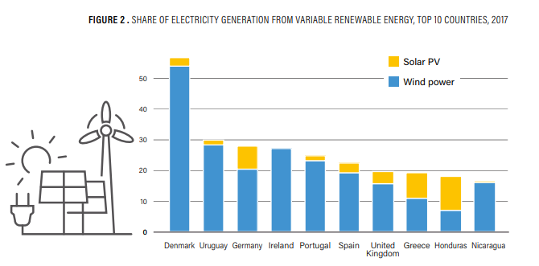
High Shares of Variable Renewable Power on the Grid
REN21 Renewables 2018 Global Status Report
Notes:
- The good news in the power sector: with solar PV and wind rising, many countries show that high shares of variable renewable energy can and are being successfully integrated into electricity systems across the globe, without affecting grid stability.
Penetration reached significant levels in many regions in 2017, for example, Denmark (52.9%), Uruguay (28.1%), Germany (26%) and Ireland (25.2%).

Slide 18
Jobs in Renewable Energy

Slide 19
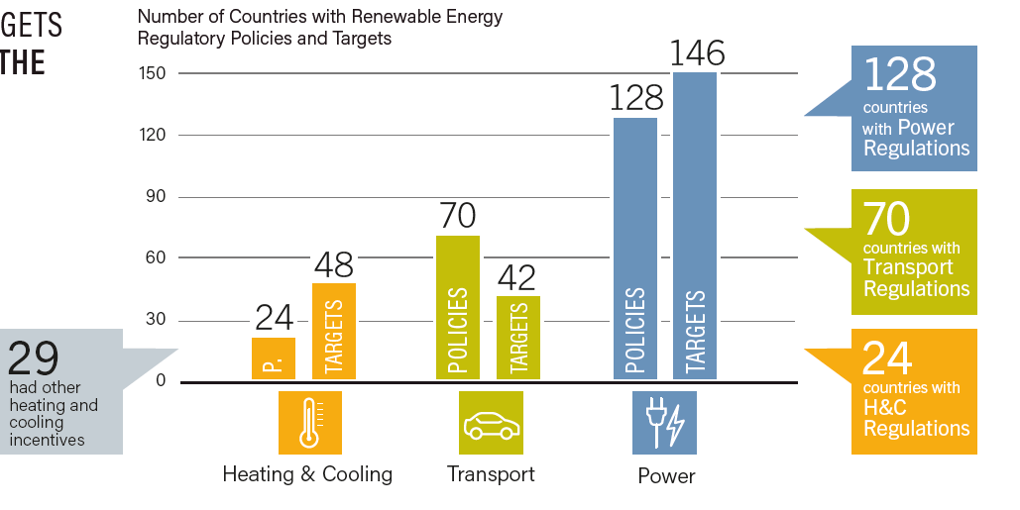
Renewable Energy Policy Landscape
179 countries had renewable energy targets
146 countries had power targets
42 countries had transport targets
48 countries had heating and cooling targets
57 jurisdictions with carbon pricing policies
REN21 Renewables 2018 Global Status Report
Notes:
- Policy support for renewable energy in 2017, as in past years, focused mostly on power generation, whereas support for renewable technologies in the heating and cooling and transport sectors developed at a slower pace.
As of year-end 2017, 179 countries had implemented renewable energy targets.
146 countries had power targets
42 countries had transport targets
48 countries had heating and cooling targets
57 jurisdictions with carbon pricing policies

Slide 20
Renewable Energy Policy Landscape
Notes:
- Policy support for renewable energy in 2017, as in past years, focused mostly on power generation, whereas support for renewable technologies in the heating and cooling and transport sectors developed at a slower pace.
As of year-end 2017, 179 countries had implemented renewable energy targets.
146 countries had power targets
42 countries had transport targets
48 countries had heating and cooling targets
57 jurisdictions with carbon pricing policies

Slide 21
Renewable Energy Policy Landscape
Notes:
- Policy support for renewable energy in 2017, as in past years, focused mostly on power generation, whereas support for renewable technologies in the heating and cooling and transport sectors developed at a slower pace.
As of year-end 2017, 179 countries had implemented renewable energy targets.
146 countries had power targets
42 countries had transport targets
48 countries had heating and cooling targets
57 jurisdictions with carbon pricing policies

Slide 22
Energy Efficiency

Slide 23
Targets for RE and EVs

Slide 24
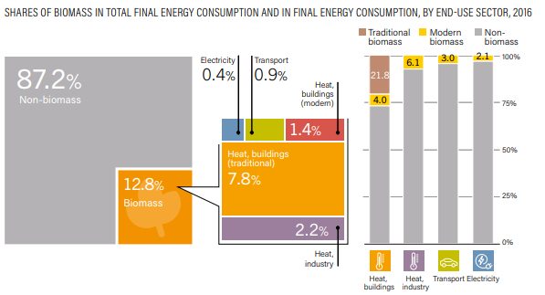
Bioenergy

Slide 25
Bioenergy

Slide 26
Bioenergy

Slide 27
Bioenergy

Slide 28
Geothermal Power and Heat

Slide 29
Geothermal Power and Heat

Slide 30
Hydropower

Slide 31
Hydropower

Slide 32
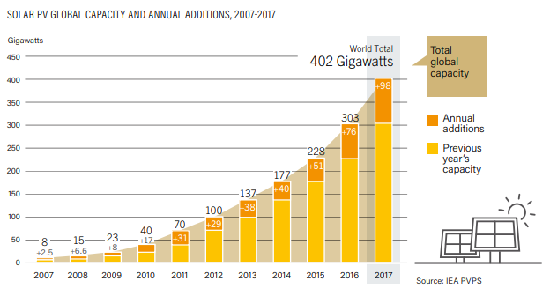
Solar PV
98 GW of solar PV capacity added in 2017
Global total increased 33% to 402 GW (40,000 PV panels every hour)
More solar PV was installed than the net capacity additions of fossil fuels and nuclear power combined
REN21 Renewables 2018 Global Status Report
Notes:
As mentioned already, in 2017, solar PV was the driving force
Solar PV had another landmark year in 2017.
At least 98 GW (in direct current) of solar PV capacity was added worldwide - equivalent to the installation of more than 40,000 solar panels every hour.
By year's end, global solar PV capacity totalled at least 402 GW (+33% increase) = more than the net capacity additions of fossil fuels and nuclear power combined

Slide 33
Solar PV
REN21 Renewables 2018 Global Status Report

Slide 34
Solar PV
REN21 Renewables 2018 Global Status Report

Slide 35
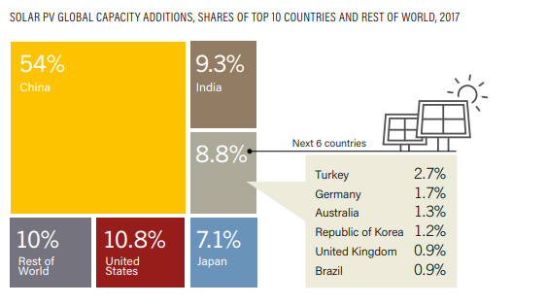
Solar PV
China added 53.1 GW in 2017, more than was added worldwide in 2015, increasing its total solar PV capacity to 131.1 GW
China reached its 2020 target for solar installations in 2017
REN21 Renewables 2018 Global Status Report
Notes:
The significant market increase in solar PV was due primarily to China, where new installations were up more than 50%.
China added 53.1 GW of solar PV in 2017, more than was added worldwide in 2015 (51 GW).
By year’s end, total solar PV capacity in China approached 131.1 GW, surpassing the government’s minimum target for 2020 (105 GW) which had been announced in 2016.

Slide 36
Concentrating Solar Thermal Power (CSP)
Notes:
The significant market increase in solar PV was due primarily to China, where new installations were up more than 50%.
China added 53.1 GW of solar PV in 2017, more than was added worldwide in 2015 (51 GW).
By year’s end, total solar PV capacity in China approached 131.1 GW, surpassing the government’s minimum target for 2020 (105 GW) which had been announced in 2016.

Slide 37
Concentrating Solar Thermal Power (CSP)
Notes:
The significant market increase in solar PV was due primarily to China, where new installations were up more than 50%.
China added 53.1 GW of solar PV in 2017, more than was added worldwide in 2015 (51 GW).
By year’s end, total solar PV capacity in China approached 131.1 GW, surpassing the government’s minimum target for 2020 (105 GW) which had been announced in 2016.

Slide 38
Solar Thermal Heating and Cooling
Notes:
The significant market increase in solar PV was due primarily to China, where new installations were up more than 50%.
China added 53.1 GW of solar PV in 2017, more than was added worldwide in 2015 (51 GW).
By year’s end, total solar PV capacity in China approached 131.1 GW, surpassing the government’s minimum target for 2020 (105 GW) which had been announced in 2016.

Slide 39
Solar Thermal Heating and Cooling
Notes:
The significant market increase in solar PV was due primarily to China, where new installations were up more than 50%.
China added 53.1 GW of solar PV in 2017, more than was added worldwide in 2015 (51 GW).
By year’s end, total solar PV capacity in China approached 131.1 GW, surpassing the government’s minimum target for 2020 (105 GW) which had been announced in 2016.

Slide 40
Solar Thermal Heating and Cooling
Notes:
The significant market increase in solar PV was due primarily to China, where new installations were up more than 50%.
China added 53.1 GW of solar PV in 2017, more than was added worldwide in 2015 (51 GW).
By year’s end, total solar PV capacity in China approached 131.1 GW, surpassing the government’s minimum target for 2020 (105 GW) which had been announced in 2016.

Slide 41
Solar Thermal Heating and Cooling
Notes:
The significant market increase in solar PV was due primarily to China, where new installations were up more than 50%.
China added 53.1 GW of solar PV in 2017, more than was added worldwide in 2015 (51 GW).
By year’s end, total solar PV capacity in China approached 131.1 GW, surpassing the government’s minimum target for 2020 (105 GW) which had been announced in 2016.

Slide 42
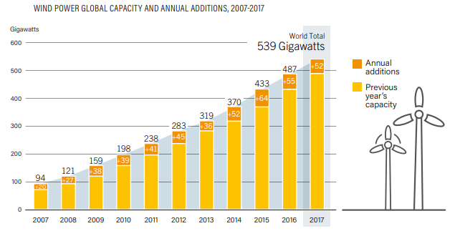
Wind Power
52 GW of wind power capacity added in 2017, increasing the global total by 11% to 539 GW
China retained its lead position for wind power as well, adding nearly 19.7 GW and reaching a total of 188.4 GW
Although onshore wind represents the majority of installed capacity for wind, there was an increase of +30% in global offshore capacity
REN21 Renewables 2018 Global Status Report
Notes:
- Although wind had a relatively modest year - a significant decline in the Chinese market was responsible for most of the market contraction - wind was the other major contributor to the transition
52 GW of wind power capacity was added in 2017, increasing the global total about +11% to some 539 GW.
China retained its lead for new installations, followed distantly by the United States and Germany.
Although onshore wind power continues to account for the vast majority (more than 96%) of global installed capacity, total world offshore capacity increased by 30%, to 18.8 GW.

Slide 43
Wind Power
Notes:
- Although wind had a relatively modest year - a significant decline in the Chinese market was responsible for most of the market contraction - wind was the other major contributor to the transition
52 GW of wind power capacity was added in 2017, increasing the global total about +11% to some 539 GW.
China retained its lead for new installations, followed distantly by the United States and Germany.
Although onshore wind power continues to account for the vast majority (more than 96%) of global installed capacity, total world offshore capacity increased by 30%, to 18.8 GW.

Slide 44
Wind Power
Notes:
- Although wind had a relatively modest year - a significant decline in the Chinese market was responsible for most of the market contraction - wind was the other major contributor to the transition
52 GW of wind power capacity was added in 2017, increasing the global total about +11% to some 539 GW.
China retained its lead for new installations, followed distantly by the United States and Germany.
Although onshore wind power continues to account for the vast majority (more than 96%) of global installed capacity, total world offshore capacity increased by 30%, to 18.8 GW.

Slide 45
Wind Power
Notes:
- Although wind had a relatively modest year - a significant decline in the Chinese market was responsible for most of the market contraction - wind was the other major contributor to the transition
52 GW of wind power capacity was added in 2017, increasing the global total about +11% to some 539 GW.
China retained its lead for new installations, followed distantly by the United States and Germany.
Although onshore wind power continues to account for the vast majority (more than 96%) of global installed capacity, total world offshore capacity increased by 30%, to 18.8 GW.

Slide 46
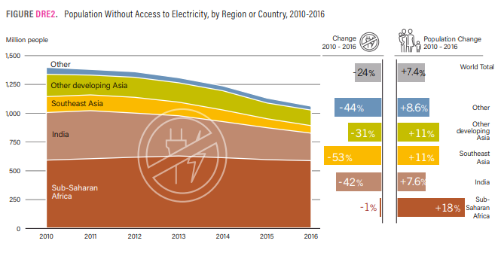
Distributed Renewables for Energy Access
In 2016:
~14% of the global population lived without electricity – approx. 1.06 billion people
DREA systems were serving ~300 million people by end-2016
REN21 Renewables 2018 Global Status Report
Notes:
This is particularly important in the context of the SDGs, especially SDG 7.1. on reaching universal energy access
Approximately 1.06 billion people (about 14% of the global population) lived without electricity in 2016, about 125 million fewer people than in 2014.
The vast majority of people without access to electricity and clean cooking are in sub-Saharan Africa and the Asia-Pacific region, and most of them live in rural areas.
Renewable energy offers many opportunities to tackle this challenge, with
Larger scale grid connected generation, that is more cost-efficient and realitvely quick to install
Distributed renewables for energy access (DREA) systems that play a very important role in improving energy access. which were serving an estimated 300 million people by the end of 2016.

Slide 47
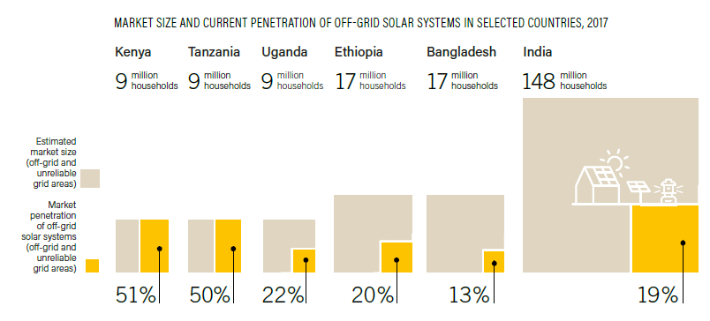
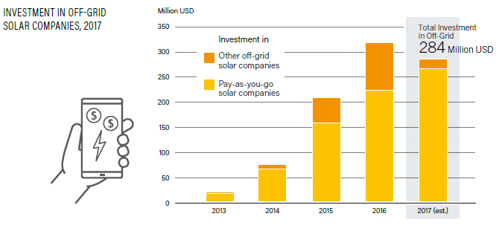
Distributed Renewables for Energy Access
Off-grid solar devices (e.g. solar lanterns and solar home systems) experienced 60% annual growth rates between 2010-2017
130 million off-grid solar systems had been sold cumulatively by end-2017
PAYG companies raised USD 263 million in capital (+19% from 2016)
REN21 Renewables 2018 Global Status Report
Notes:
- Off-grid solar devices such as solar lanterns and solar home systems experienced 60% annual growth rates between 2010 and 2017
Some 130 million quality-assured off-grid solar systems had been sold cumulatively by the end of 2017, providing electricity access to about 360 million people worldwide.
Investment in off-grid solar PV in 2017 was lower than in 2016, but still dominated by investments in PAYG companies.
All of this to say that renewable energy has a role to play both on- and off-grid, in centralized and de-centralized systems; the fact that developing countries are investing in off-grid solar systems reinforces the potential of renewables to increase electricity access.
This also highlights the need for better data concerning decentralized energy systems across the globe, as much is happening, but not visible for energy planning, policy design and investment

Slide 48
Distributed Renewables for Energy Access

Slide 49
Distributed Renewables for Energy Access

Slide 50
Distributed Renewables for Energy Access

Slide 51
Distributed Renewables for Energy Access

Slide 52
Distributed Renewables for Energy Access

Slide 53
Distributed Renewables for Energy Access

Slide 54
Distributed Renewables for Energy Access

Slide 55
Distributed Renewables for Energy Access

Slide 56
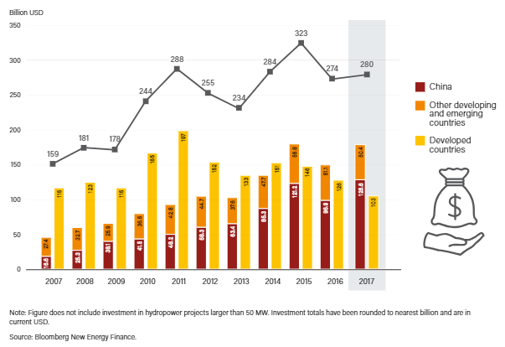
Global Investment in Renewable Energy
Global new investment in renewable power and fuels in 2017: USD 279.8 billion (+2%) (USD 319.8 billion incl. large hydropower)
Investment in new renewable power capacity was roughly three times that in new fossil fuel capacity
REN21 Renewables 2018 Global Status Report
Notes:
This development is also reflected in global investment figures
Global new investment in renewable power and fuels (not incl. hydropower projects >50 MW) was close to USD 280 billion in 2017 (as estimated by Bloomberg New Energy Finance).
This represents a 2% increase in investment in relation to 2016 which means that, although costs keep going down for renewable energies (particularly for solar PV and wind), investment in renewable power is increasing.
In fact, investment in renewable power capacity in 2017 was three times higher than investment in new fossil fuel capacity. This is great news!

Slide 57
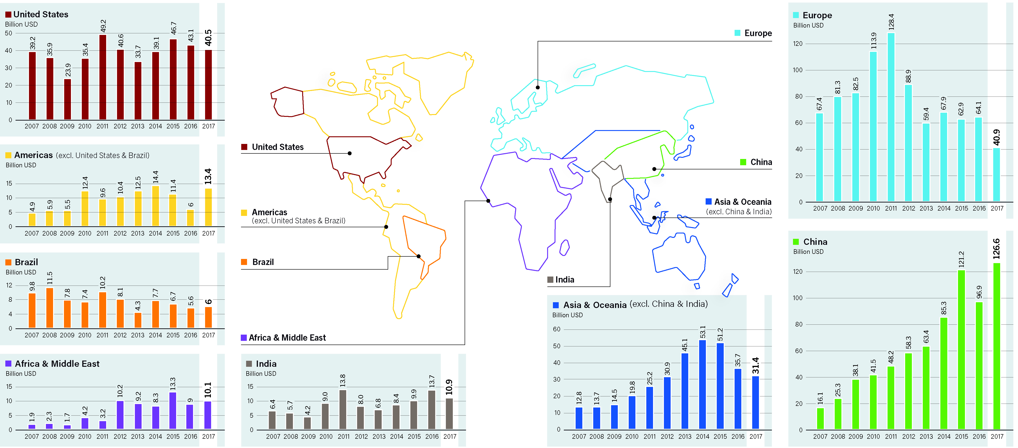
Global Investment in Renewable Energy
REN21 Renewables 2018 Global Status Report
Notes:
- When looking at the global energy transition, it is also important to look at regional differences, e.g. trends in renewable energy investment varied by region.
- In 2017, China, Europe and the United States accounted for nearly 75% of the global investment in renewable power and fuels.
China’s high level of investment – an increase of 30.7% from the previous year – distorts the overall investment picture. Investment in developing countries actually decreased by 1.4%. In developed countries, overall investment fell by 18.3%.
Developing countries installed less than one-fifth the renewable energy capacity of developed countries and less than one tenth that the emerging economies of Brazil, India and China together (led largely by China).

Slide 58
Global Investment in Renewable Energy
Notes:
-

Slide 59
Global Investment in Renewable Energy

Slide 60
Energy Systems Integration and Enabling Technologies

Slide 61
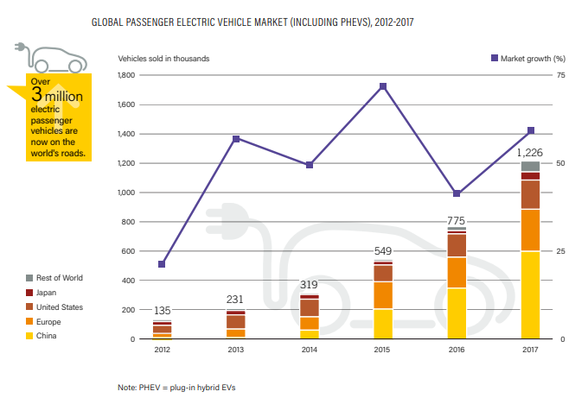
Energy Systems Integration and Enabling Technologies
REN21 Renewables 2018 Global Status Report

Slide 62
Energy Efficiency

Slide 63
Energy Efficiency

Slide 64
Energy Efficiency

Slide 65
Energy Efficiency

Slide 66
Feature: Corporate Sourcing of Renewable Energy

Slide 67
Conclusions
Global renewable power transition advancing with record capacity additions and rapidly falling costs – The transition is possible!!
However, progress not fast enough to reach Paris Agreement goals and SDGs
Better-integrated sectors - planning, policies and regulatory frameworks
Systems approach: link energy efficiency and renewable energy
Create a level playing field for renewables and decentralised off-grid renewables
Make all trends visible: Much is happening, but data is not consolidated – renewables at local and sub-national level, distributed off-grid renewables, innovative business models
Notes:
- So, all in all, renewables are a reality in all sectors, but the uptake needs to be accelerated and spread to all sectors, in particular in view of climate and development goals
The overall share of renewable energy in total final energy consumption has increased only modestly in recent history. A primary reason for this is the persistently strong growth in overall energy demand, as a result of economic development of emerging markets as well as population growth
Energy-related carbon dioxide (CO2) emissions rose – by an estimated 1.4% – for the first time in four years.
- There is uneven progress between the sectors and between the different geographical regions, and a fundamental disconnect between commitments and real action on the ground. Simply put, the global renewable energy transition is progressing far too slowly.
What do 2017 developments teach us?
- RE power development show that a transition is possible!
- We need to move from a renewable electricity transformation to a renewable energy transformation.
Phase out fossil fuel and nuclear subisidies
- Thinking about the off-grid/on-grid dichotomy or the activities of local cities, we need to make all trends visible: Much is happening, but data is not consolidated – renewables at local and sub-national level, distributed off-grid renewables, innovative business models

Slide 68
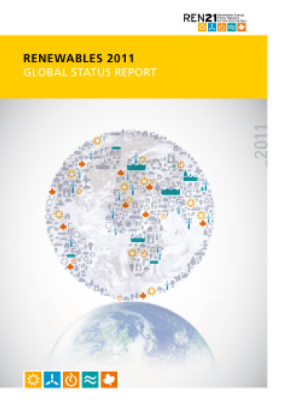
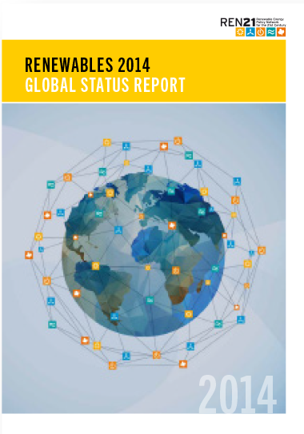
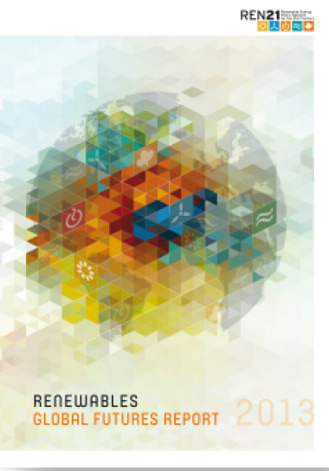
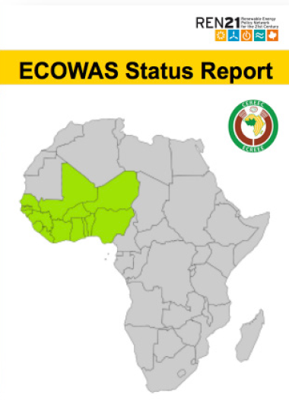
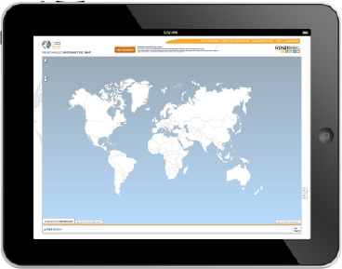
Renewable Energy Policy Network for the 21st Century
Global Status Report: yearly publication since 2005
^{Global Futures Report}
^{Regional Reports}
^{www.map.ren21.net}
^{www.ren21.net/gsr}
^{Subscribe to our newsletter}
^{www.ren21.net}
Notes:
Join the REN21 network today, subscribe to our newsletter to get regular updates about renewable energy developments globally and download REN21 reports, infographics and videos from www.ren21.net!

